Slide 1
Full Stack Using NodeJS Project - II Model Portfolio Template
Presented By: Presented To:
Ritik Gupta Mr. Mandeep Singh
(191500659) (Technical Trainer)

Slide 2
OUTLINE
About the NodeJs and React
About the HTML and SCSS
About the Javascript and Bootstrap4
About Project
Objective and use of this project
Requirements ( Software & Hardware)
Snapshots from this website with their working descriptions
Conclusion
References

Slide 3
About the NodeJS & React
Node.js is an open source server environment.
Node.js is free.
Node.js uses JavaScript on the server.
Node.js uses asynchronous programming.
React is a JavaScript library created by Facebook.
React is User Interface (UI) library.
React is a tool for building UI components.
React is used to build single page applications.

Slide 4
About the HTML & SCSS
HTML stands for Hyper Text Markup Language.
HTML is the standard markup language for creating web pages basically it describes the structure of web pages .
HTML elements tell the browser how to display the content.
SCSS is the extension of CSS. It is also known as CSS pre-processor.
When it comes to theming; that is, changing the look and fell of your website while maintaining its layout, SCSS features-like mixins or functions-can feel like taking a plane instead of walking.

Slide 5
About the JavaScript & BootStrap4
JavaScript is a lightweight, interpreted programming language.
It is designed for creating network-centric-applications.
JavaScript is very easy to implement because it is integrated with HTML. It is open and cross-platform.
JavaScript helps in developing both front-end and back-end software using different JavaScript based frameworks.
BootStrap4 is a free front-end framework for faster and easier web development.
BootStrap4 also gives you the ability to easily create responsive designs.

Slide 6
About the Project
I am making a portfolio website named “Model Portfolio Template”. It is very useful for those users who are applying for jobs such as freshers or students.
Here they can store all their projects, skills, achievements and resume and many more things which they want to showcase in front of the interviewer.
In this website there are many sections in which these above mentioned things are displayed with photos and links to respective sections are also navigated.

Slide 7
Objective of this Project
The main objective of this website is that all the main things that are required at the time of interview would not miss and would be kept safe and secure at one place.
These portfolios are very important in today’s time as nowadays, online interviews are going on, as in some cases when interviewer asks us about to send something about you then instead of sending different files one can send his/her portfolio show different sections of particulars.

Slide 8
Use of the Project Portfolios are used by working professionals, companies and students to highlight their best work and display accomplishments, skills and potential. They visually showcase examples of work, while a resume only provides bullet points. The link to digital portfolios can be included on a resume or a cover letter, or sent to an interviewer or client prior to an in-person meeting. "A person with a well-designed and -developed portfolio will stand out when competing for jobs. If all other things are equal in the competition for a job, individuals with a portfolio will win over those who don’t have one.”

Slide 9
Requirements
Software Specification Used:-
• Technology Implemented :- NodeJS, React
• Language used (frontend):- HTML, SCSS, BootStrap4
• Language used (backend):- JavaScript
• Other Technology implemented:- GitHub pages and GitHub API
• IDE :- Visual Studio code
• Other Technology Implemented are :- Google Admob

Slide 10
Hardware Specification Used:- • Processor used :- Intel i5 • Operating System used :- Windows 8/10/11 • RAM used :- 8GB • Hardware device :- Computer System • Hard disk :- 1TB • Display Screen :- Laptop Screen

Slide 11
THIS IS HOW OUR WEBSITE LOOKS
Hope you will like it :)

Slide 12
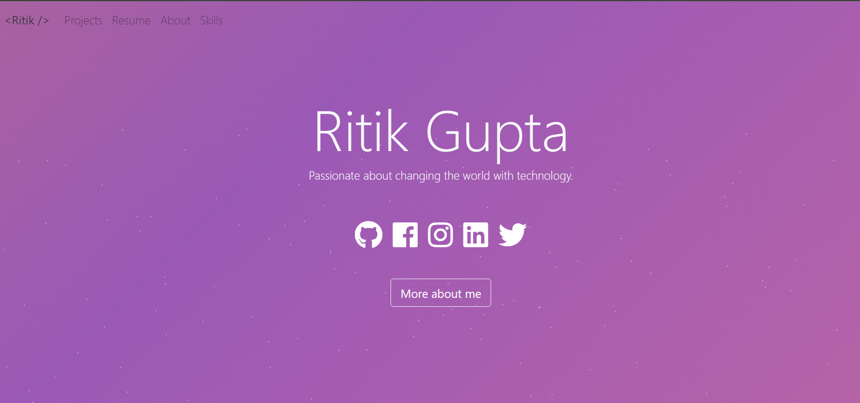
HomeSection Should display home page with a task bar showing navigation option like username, projects, resume, about, skills, get in touch sections. Some social links are also working .

Slide 13
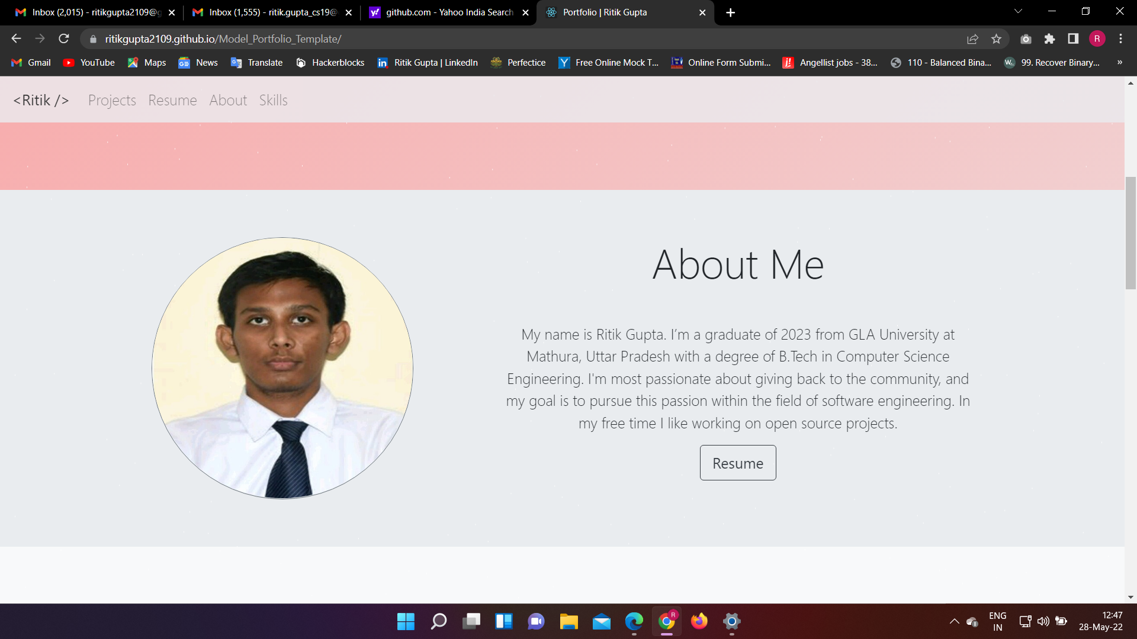
2. About Section Should display short description and resume button working properly.

Slide 14
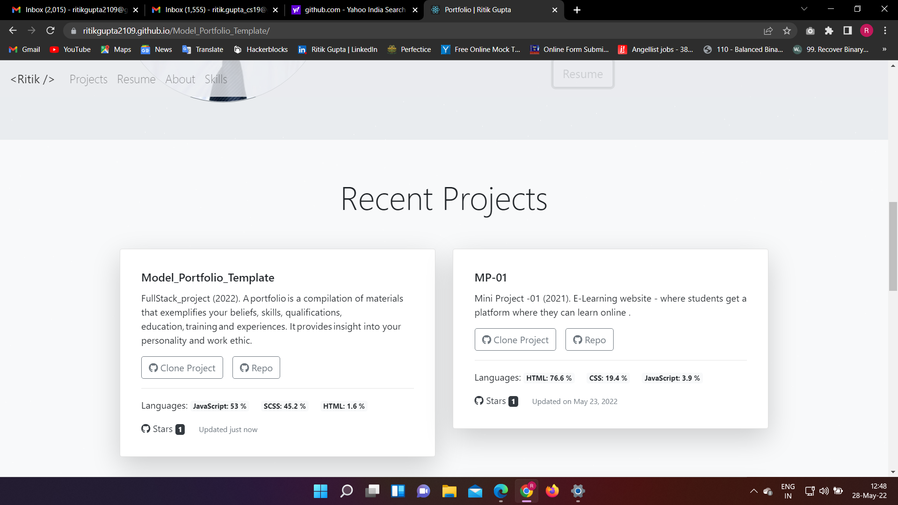
3.Project Section (a) Should display two projects through GitHub pages.

Slide 15
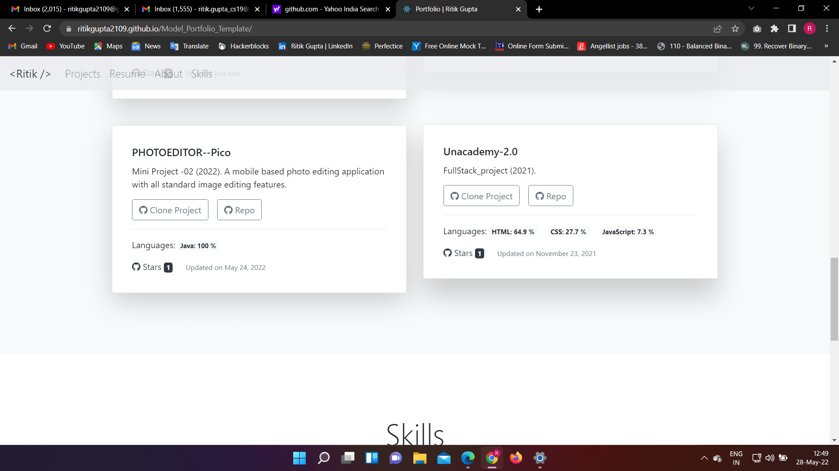
4. Project Section (b) Should display another two projects through GitHub pages.

Slide 16
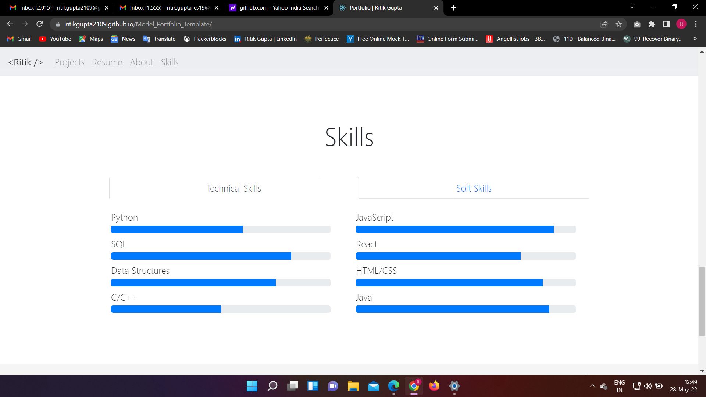
5. Technical Skills Section Should display technical skills.

Slide 17
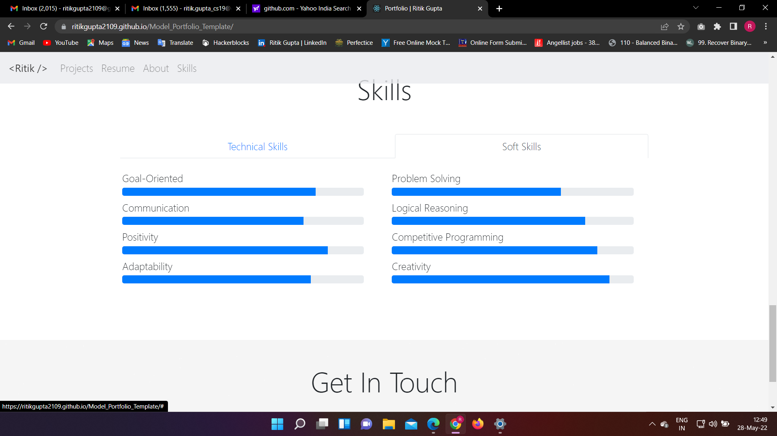
6. Soft Skills section Should display soft skills.

Slide 18
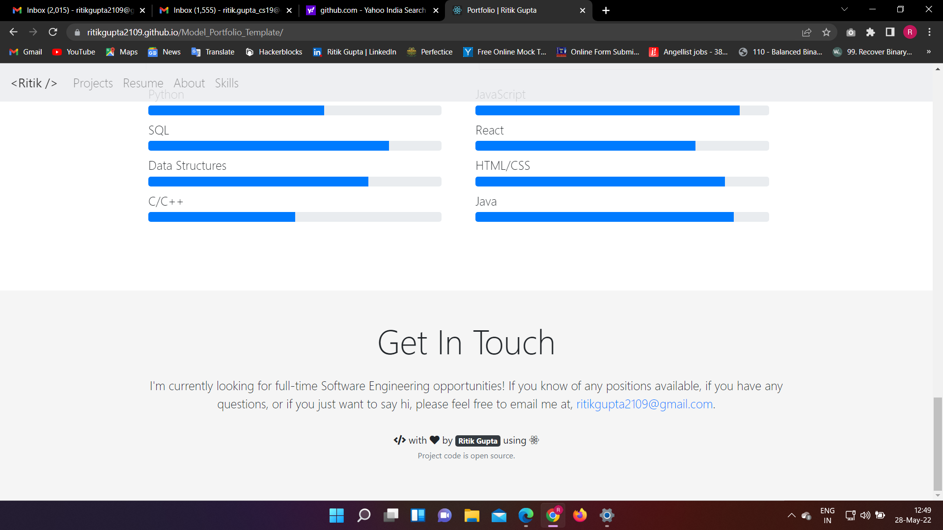
7. Get in Touch Section Should display the email id , if anybody have problem he/she can mail me

Slide 19
Conclusion Proposed Model Portfolio template is a web application that will allow users to search for or edit user name, projects, about me description, skills etc. This application takes in a user input and searches the GitHub API with the user input and gets a list of published projects based on the users search query. Search result screen will contain a list of recent projects with following details: name of project, title, average, rating of the project. To get the information of the particular project full support to user can click upon the repo from the list and then will be taken to the new tab where description and other information related to the projects will be available. Users can also add the star to the favourites. This application has wide range of scope in the upcoming era. It is impossible to arrange the hard copies of every portfolio so this type of application can reduce the barrier to get knowledge at any place in a cost effective, productive way. For students who are interested in applying for jobs can use this application and keep all the records and achievements they want to store from at one place (in favourites section) and can create their own personal portfolio with resume.

Slide 20
References 1. Internshala: https://trainings.internshala.com/ 2. For rectifying the error : https://stackoverflow.com/ 3. https://www.w3schools.com/ 4. https://shapemyskills.in

Slide 21
Thank You!!!

